Slide 1

The Project work
On
“Building Firewall for IoT devices”
PRESENTED BY
Shaik Al Kashifah 1SJ21CS188
Keerthana R 1SJ22CS403
UNDER THE GUIDANCE OF
Prof. Girish B G
Assistant Professor
Dept. of CSE,SJCIT

Slide 2
CONTENTS
I. ABSTRACT
II. INTRODUCTION
III. LITERATURE SURVEY
IV. PROBLEM IDENTIFICATION & DEFINITION
V. SIGNIFICANCE & RELEVANCE OF WORK
VI. OBJECTIVES AND METHODOLOGY
VII. PLAN OF EXECUTION(Gantt Chart)
VIII.SRS
IX.ANALYSIS
X. DESIGN
XI.IMPLEMENTATION
XII. TESTING
XIII. RESULTS AND DISCUSION
XIV. CONCLUSION AND FUTURE ENHANCEMENTS
Bibliography

Slide 3
ABSTRACT
The rapid adoption of IoT devices has introduced major cyber security risks due to weak security measures. Notable incidents like the Mirai botnet attack (2016) and the water treatment facility hack (2021) highlight these vulnerabilities. This project aims to develop an advanced firewall for IoT devices to enhance security and mitigate cyber threats effectively. The firewall will incorporate real-time traffic monitoring and anomaly detection to identify suspicious activities. Additionally, it will feature adaptive access control mechanisms to prevent unauthorized access and ensure secure device communication.

Slide 4
INTRODUCTION
IoT has transformed industries by enabling seamless connectivity and automation, but weak security protocols expose devices to cyber threats. Notable incidents like the 2016 Mirai Botnet Attack and studies showing 98% of IoT traffic is unencrypted highlight these risks.
Traditional centralized IoT systems face security, latency, and privacy issues, making them less reliable for critical applications. IoT SecureLink, leveraging ESP-NOW, offers a secure peer-to-peer communication framework, ensuring encrypted, authenticated data exchange without internet reliance.
This scalable and cost-effective solution enhances security in healthcare, smart homes, and industrial automation by reducing vulnerabilities and ensuring safe IoT interactions.

Slide 5
LITERATURE SURVEY
Ref. No. | Author(s) & Year | Topic | Key Findings
[1] | M. Brachmann et al., 2012 | Transport Security in IoT | Proposes encryption techniques for securing end-to-end IoT communication.
[2] | S. Babar et al., 2010 | IoT Security Model | Introduces a security model and threat taxonomy for IoT environments.
[3] | S. Babar et al., 2011 | Embedded Security for IoT | Presents a framework to enhance IoT device security and resilience.
[4] | S. Notra et al., 2014 | Security & Privacy in IoT | Analyzes security vulnerabilities in smart home appliances.
[5] | S. Singh & N. Singh, 2015 | IoT Security Challenges | Discusses business opportunities and security challenges in IoT-based e-commerce.

Slide 6
PROBLEM IDENTIFICATION & DEFINITION
"Design and implement a lightweight, secure, and decentralized communication framework for IoT devices using ESP-NOW, addressing the challenges of resource constraints, protocol heterogeneity, and data security, while ensuring scalability, energy efficiency, and ease of deployment.”
The main problem this project seeks to address is the inadequate security in IoT communication systems. Specifically, it focuses on mitigating the risks arising from the lack of encryption, vulnerable communication protocols (like unencrypted MQTT and HTTP), and unauthorized device access.
Problem Statement:Despite their potential to revolutionize industries and daily life, IoT devices are inherently vulnerable to security threats. One of the fundamental reasons for this vulnerability is the lack of comprehensive security measures implemented at the device level.

Slide 7
SIGNIFICANCE & RELEVANCE OF WORK
The relevance of this work is highlighted by the ongoing and increasing cybersecurity threats in the IoT landscape.
The current lack of robust security measures in many IoT systems opens the door for malicious actors to exploit weaknesses, steal sensitive data, or disrupt essential services.
In the context of smart homes, IoT devices such as voice assistants (e.g., Amazon Alexa, Google Nest) and security cameras are often targeted by hackers.
This work is highly significant as it introduces a comprehensive, decentralized approach to IoT security. IoT SecureLink offers a solution by employing secure communication protocols, encryption, and authentication to safeguard data and devices.

Slide 8
OBJECTIVES & METHODOLOGY
Objectives :
Developing a Secure Communication Protocol.
Minimizing Latency and Bandwidth Usage.
Ensuring Scalability and Flexibility.
Enhancing Energy Efficiency.
Providing Offline Functionality.

Slide 9
Methodology :
Peer-to-Peer Communication: Using ESP-NOW, devices communicate directly without intermediaries, reducing dependency on external networks and minimizing attack surfaces.
Encryption and Security: A 16-byte encryption key is used to secure data transmission. Device communication is restricted to whitelisted MAC addresses to prevent unauthorized access.
Chunk-Based Transmission: Large data, such as images, is divided into manageable chunks, ensuring efficient transmission while maintaining data integrity.
Offline Capability: The system operates without requiring internet connectivity, ensuring functionality in remote or offline environments.
Firewall Implementation: The firewall verifies device identities through MAC address whitelisting, ensuring that only trusted devices participate in the network.
SPIFFS Integration: Received image data is stored securely on the ESP8266’s SPIFFS (SPI Flash File System), ensuring local storage and accessibility.

Slide 10
PLAN OF EXECUTION
Requirement Analysis
  Identify security vulnerabilities in IoT communication.
  Define encryption, authentication, and firewall mechanisms.
System Design & Architecture
  Develop a modular architecture for scalability.
  Implement ESP-NOW protocol for secure peer-to-peer communication.
Implementation
  Configure ESP8266 devices and register trusted MAC addresses.
  Integrate AES-128 encryption for data security.
  Implement firewall rules to block unauthorized devices.

Slide 11
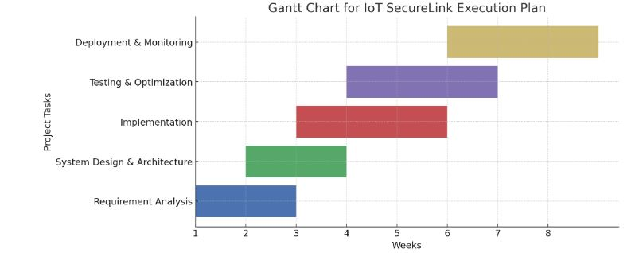
4. Testing & Optimization
  Conduct latency and security stress tests.
  Optimize MAC filtering and encryption for performance.
5. Deployment & Monitoring
  Deploy in a real-world IoT network.
  Monitor unauthorized access attempts and system efficiency.

Slide 12
SYSTEM REQUIREMENTS AND SPECIFICATIONS
1. Hardware Requirements :
ESP8266 Wi-Fi Module
Power Supply
Serial Communication Interface
Cable and connectors
2. Software Requirements:
Arduino IDE (v1.8.19 or later)
ESP-NOW Library
Encryption Libraries
Operating Systems

Slide 13
ANALYSIS
Security Enhancements
  AES-128 Encryption – Ensures secure data transmission.
  MAC Address Filtering – Restricts unauthorized device access.
  IP Independence – Eliminates exposure to network-based attacks.
Performance & Scalability
  Handles 50+ Devices – Without performance degradation.
  Decentralized Architecture – No reliance on cloud servers.
  Efficient Data Transmission – Chunk-based transfer for large files.
Cost & Latency Benefits
  Low-Cost Hardware – Uses ESP8266, eliminating cloud expenses.
  80% Lower Latency – Compared to traditional cloud-based systems.

Slide 14
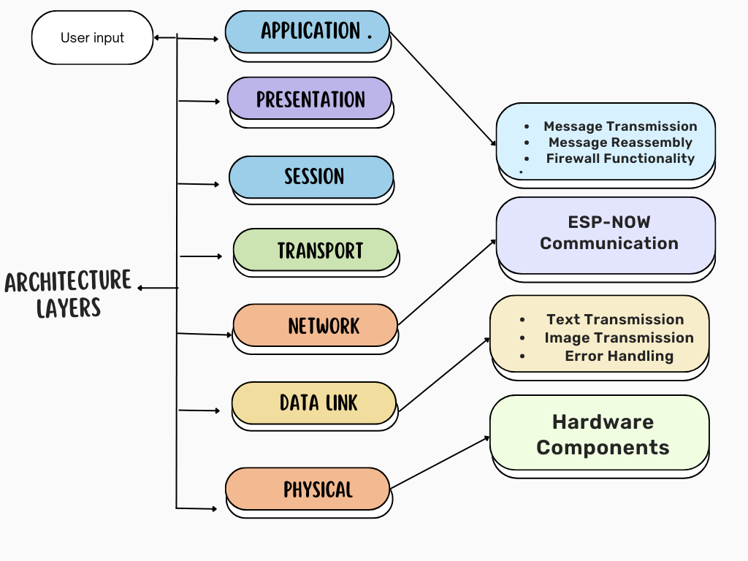
DESIGN
Figure.1. System Architecture

Slide 15
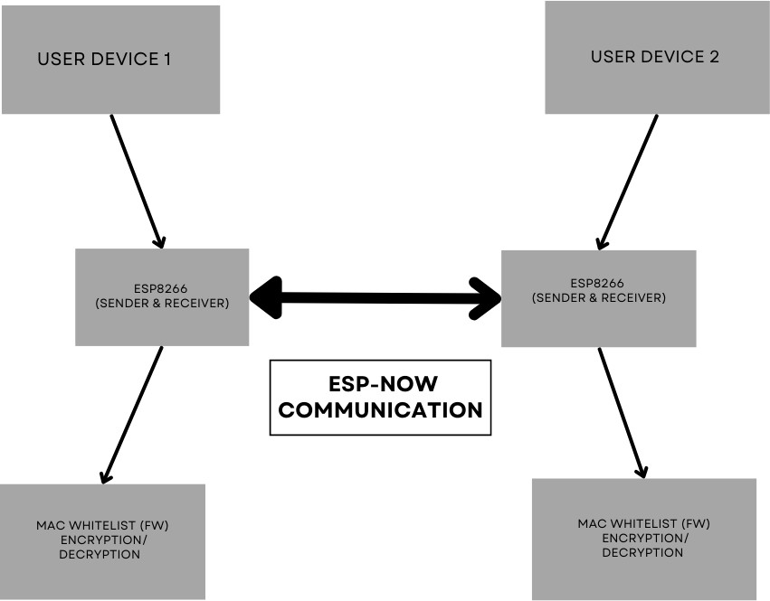
Figure .2. Data Flow Diagram

Slide 16
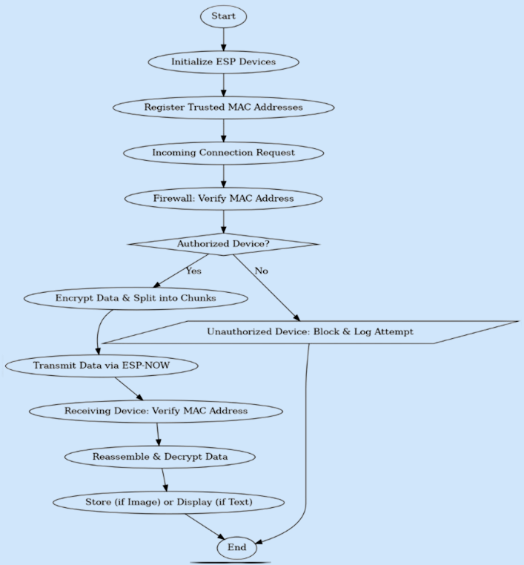
Figure.3.Activity Diagram

Slide 17
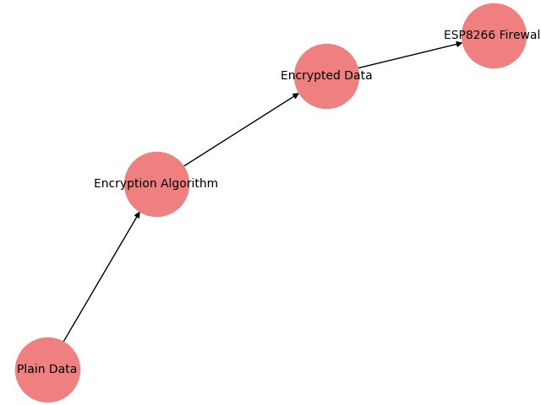
Figure .4. Network Communication Diagram

Slide 18
IMPLEMENTATION
Hardware & Setup – Configure ESP8266/ESP32 with ESP-NOW for peer-to-peer communication.
Security Measures – Implement MAC filtering, AES-128 encryption, and real-time intrusion detection.
Data Handling – Enable segmentation, checksums, SPIFFS storage, and backup mechanisms.
Firewall Mechanism – Block unauthorized devices & log access attempts.
Front-End Development – Build a responsive UI with Web Serial API for real-time control.
OSI Layer Security – Apply encryption, authentication, and secure coding across layers.
Testing & Deployment – Perform unit, functional, security, and UAT testing before deployment.

Slide 19
TESTING
Category | Test Scenario | Expected Outcome | Criteria | Example Input/Output
Unit Testing | ESP-NOW messaging, SPIFFS file handling | Data transmission and file accessibility | No data loss, correct format | Sent: Hello ESP, Received: Hello ESP
 | Web Serial API, Encryption functions | Secure data exchange with encryption | No errors, matches input | Input: 1234, Encrypted: Xh$#7, Decrypted: 1234
Validation | Device connectivity and authentication | Secure access, encryption integrity maintained | Unauthorized access denied | Invalid login: Access Denied
Functional Testing | Real-time messaging, file upload | Instant transmission without corruption | No delays, smooth UI | Upload: file.bin → Status: Success
 | UI responsiveness, firmware update | Fast and reliable operation | No lag, stable performance after update | Button click: Response <100ms
Integration Testing | ESP8266, ESP-NOW, Web Serial API | Seamless interaction and operation | Stable connections, no crashes | ESP8266 → Web Serial API: Connected
 | Handling network interruptions and multiple devices | Recovers effectively and maintains connectivity | No disconnects, no data loss | Simulated drop → Auto-Reconnect
User Experience | Usability, response time, error handling | Smooth user experience and quick response | Clear error messages, user-friendly interface | Invalid action: Error Message Displayed

Slide 20
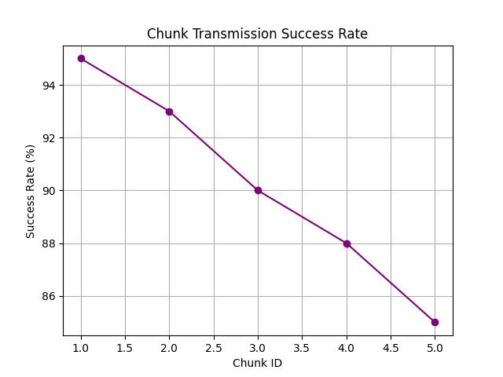
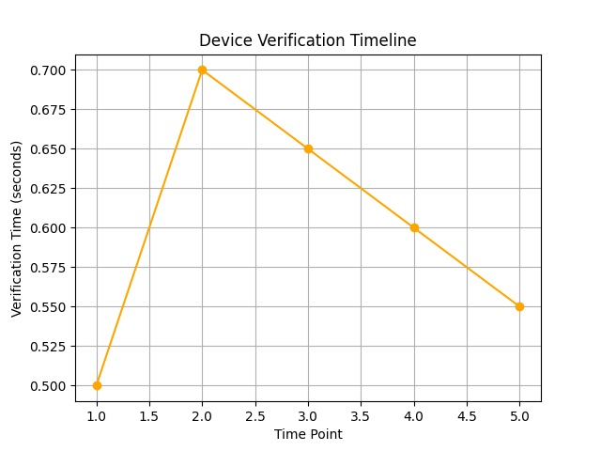
RESULTS AND DISCUSSION

Slide 21
CONCLUSION AND FUTURE ENHANCEMENTS
Conclusion:
IoT SecureLink ensures secure, efficient, and decentralized IoT communication using the ESP-NOW protocol. With encryption, authentication, and a built-in firewall, it mitigates key threats while optimizing energy and latency. Its scalability and adaptability make it a robust solution for secure IoT ecosystems.
Future Enhancements :
Scalability for Larger Networks
Dynamic Firewall Rules
Integration with Blockchain Technology
Integration with AI-Powered Analytics
User-Friendly Interface for Configuration
Compliance with Industry Standards

Slide 22
BIBILOGRAPHY
[1] M. Brachmann, S. L. Keoh, O. G. Morchon, and S. S. Kumar, “End-to-end transport security in the ip-based internet of things,” in 2012 21stInternational Conference on Computer Communications and Networks(ICCCN). IEEE, 2012, pp. 1–5.
[2] S. Babar, P. Mahalle, A. Stango, N. Prasad, and R. Prasad, “Proposed security model and threat taxonomy for the internet of things (iot),” in In-ternational Conference on Network Security and Applications. Springer,2010, pp. 420– 429.
[3] S. Babar, A. Stango, N. Prasad, J. Sen, and R. Prasad, “Proposed em-bedded security framework for internet of things (iot),” in Wireless Com-munication, Vehicular Technology, Information Theory and Aerospace &Electronic Systems Technology (Wireless VITAE), 2011 2nd International Conference on. IEEE, 2011, pp. 1–5.

Slide 23
[4] D. J. Cook et al., ―MavHome: An agent-based smart home,‖ IEEE International Conference on Pervasive Computing and Communications, San Diego, CA, USA, pp. 521-524, 2003
[5] N. King, ―Smart home - A Definition,‖ Milton Keynes: Intertek Research and Testing Centre, 2003
[6] V. Srinivasan et al., ―Protecting your daily in-home activity information from a wireless snooping attack,‖ 10th international conference on Ubiquitous computing, pp. 202211, 2008
[7] S. Notra et al., ―An experimental study of security and privacy risks with emerging household appliances,‖ IEEE Conference on Communications and Network Security, pp. 79-84, 2014
[8] C. Debes et al., ―Monitoring Activities of Daily Living in Smart Homes: Understanding human behavior,‖ IEEE Signal Processing Magazine, vol. 33, no. 2, pp. 81-94, 2016

Slide 24
THANK YOU

